Slide 1
Disability Justice & Disaster Assistance
By Valerie Novack & Justice Shorter

Slide 2
Grounding
Acknowledgement of WHY we are here
Express a commitment to centering those WHO are most impacted
Examine WHERE you enter
Explore WHAT you would like to do
Content warnings
Create collective access
This presentation is NOT set in stone
All content and frameworks are ever-evolving
2

Slide 3
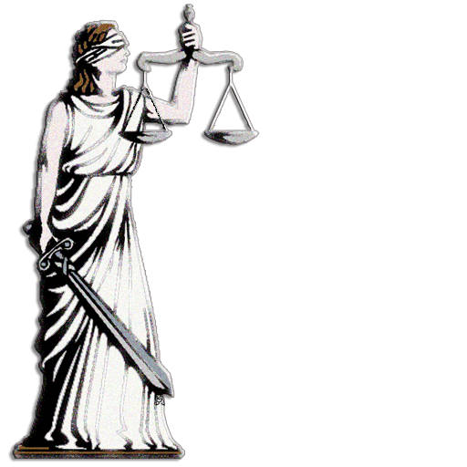
Disability Rights Don’t Dissolve During Disasters
ADA Title II
Access & Accommodations
Section 504 of the Rehabilitation Act of 1973
Federal Funding, Resources & Services
Olmstead
Deinstitutionalizations and vaccine de-prioritization during COVID
IDEA
Students with disabilities during disasters/emergencies
State laws where applicable
Emergency Declarations for weather events, protests/uprisings, terror attacks, racism as a public health crises etc.

Slide 4
What Is Disability Justice? Sins Invalid
Disability justice is a framework coined by a group of queer, disabled women of color that were connected through Sins Invalid, a US-based performance project that incubates and celebrates artists with disabilities, centralizing artists of color and queer and gender-variant artists as communities who have been historically marginalized.
Disability justice recognizes the complexities of multiply marginalized disabled people and aims to be holistic in by recognizing these complexities.
Sins Invalid has created 10 Principles of Disability Justice that, when applied to your work, can help to create a more inclusive, and aware, justice-based response.
4

Slide 5
The 10 Principles of Disability Justice
Intersectionality
Leadership by the most impacted
Anti-Capitalist Politic
Commitment to Cross-Movement Organizing
Recognizing Wholeness
Sustainability
Commitment to Cross-Disability Solidarity
Interdependence
Collective Access
Collective Liberation
5

Slide 6
Why do we need DJ in EM?
Disability Justice picks up where Disability Rights leaves off
There is collective trauma and harm to marginalized communities in current emergency practices that must be addressed at systemic levels
Multiple tools and tactics are needed to help communities survive and thrive. Justice isn’t always achieved via legal & legislative systems and not everyone has equal access to legal supports.
Disability Rights focuses on dismantling systemic discrimination
Disability Justice focuses on how we can build and bridge beyond those systems
Justice isn’t always achieved via legal & legislative systems and not everyone has equal access to legal supports.
Disability Rights focuses on dismantling systemic discrimination
Disability Justice focuses on how we can build and bridge beyond those systems
6

Slide 7
Some Causes of Harm
Policing, Prisons & Surveillance
Who gets surveilled, criminalized, institutionalized, scapegoated and policed throughout EM cycles?
Gaslighting/Discrimination/ from Government Representatives, Case Managers & Voluntary Organizations
Sex/Labor Trafficking
Domestic Violence/Gender-based violence
Economic Exploitation
Abuse/Neglect by organizations/individuals providing resource assistance, skills training and/or advocacy
Exclusion/Erasure in EM
Intentional Divestment in Mitigation/Sustainable Infrastructure Within Communities Of Color as well as rural areas
Medical Ableism/Racism
7

Slide 8
DJ is Always Applicable in a Crisis
Slow Onset vs. Sudden Onset Crises (Sustainability/Cross Disability Solidarity)
Syndemic: Simultaneous and synergetic epidemics that develop under health disparities caused by poverty, stress, or structural violence. (Interdependence)
Physiological Impacts: Weathering Hypothesis during a Public Health Crisis (Intersectionality)
Collective & Individual Trauma: Baseball Bat vs. Sandpaper (Recognizing Wholeness)
8

Slide 9
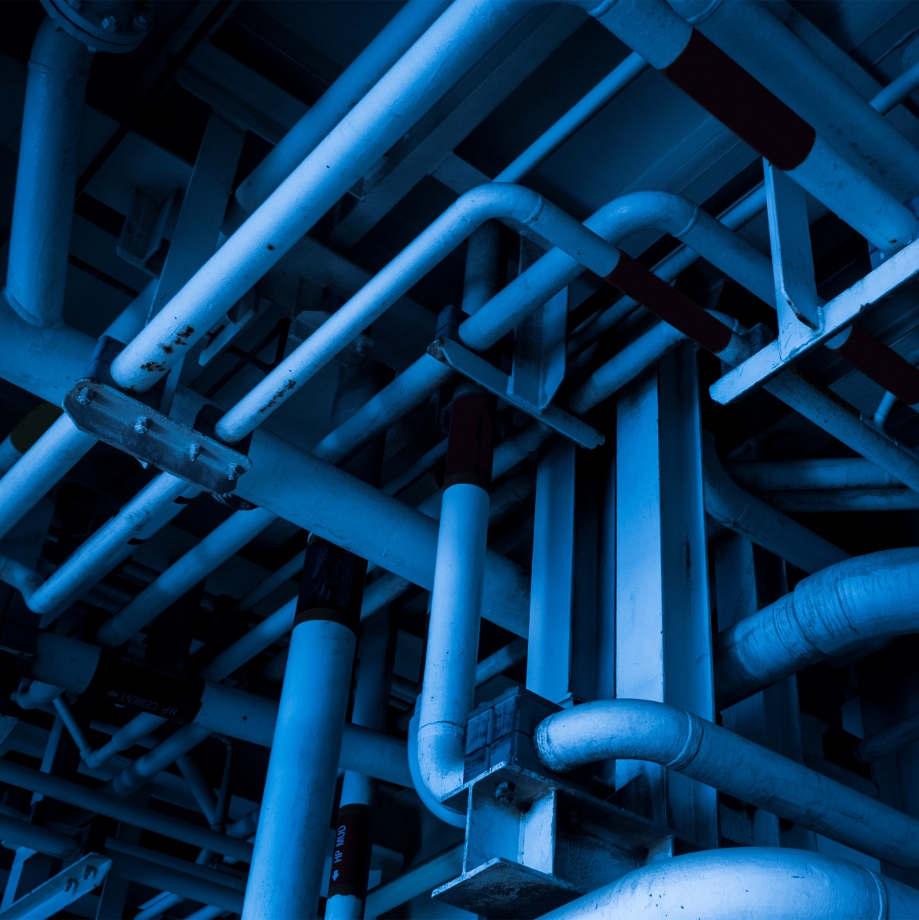
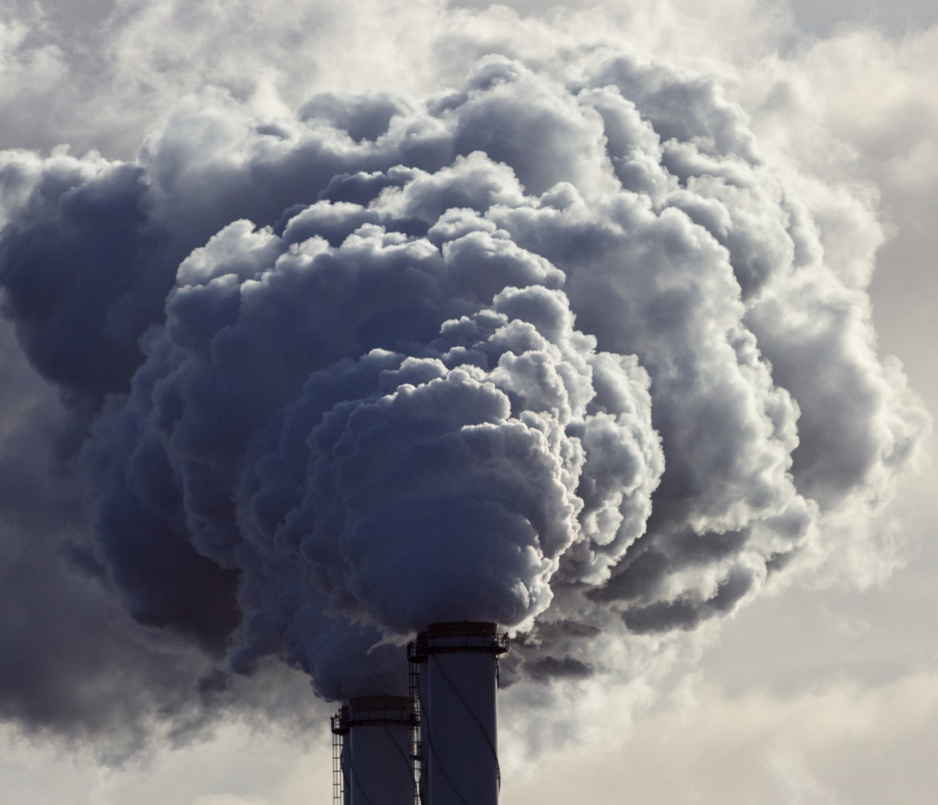
Environmental Inequities
Mold, vermin, lead & insufficient insolation/ventilation
Air pollution
Toxic dump sites
Food swamps/food deserts
Polluted water
Oil pipelines through Indigenous lands
Lack of green spaces
Oil/chemical spills
Factory emissions

Slide 10
Emergency Management Systems
Centerpiece of connectivity during multi-agency responses to disasters
Legally required to include people w/ disabilities throughout all phases of EM
May or may not:
have a designated person for disability inclusion/access & functional needs
consistently engage diverse stakeholders
allocate adequate funding for accommodations/accessibility
May have harmful history in certain communities
May be connected to law enforcement systems
Example: Police and National Guard can be deployed during all types of EM declarations such as protests, domestic terror events and for search and rescue/evacuation

Slide 11
Inextricable Links
Emergency/Crisis Management requires Disability Justice (Center Those Most Impacted)
Climate/Environmental Justice requires Disability Justice (Sustainability)
Transformative Justice requires Disability Justice (Collective Liberation)
Racial Justice requires Disability Justice (Intersectionality)
Healing Justice requires Disability Justice (Recognizing Wholeness)
Justice for LGBTQIA Folks requires Disability Justice (Cross Movement Organizing)
Economic Justice requires Disability Justice (Anti Capitalist Politic)
Educational Justice requires Disability Justice (Collective Access)

Slide 12
Advocating For Systemic Change
Recognition of Histories Of Harm
Acknowledgement
Public Apologies
Organizational Accountability
Transformative Change/Consequences vs. Traditional Punishments/Penalties
What is being negotiated, compromised, changed and sustained?
Who decides the metrics of success and why?

Slide 13
Advocating For Systemic Change (continued)
Redress & Meaningful Change
Policy change without programmatic, practical and behavioral change is not equity but rather an empty promise.
“Apology without change is manipulation”
– Rachel Ricketts

Slide 14
Actions to Consider
Please review the accompanying Actions To Consider handout for a wide array of strategies and approaches that integrate Disability Justice into disaster assistance, emergency management & crisis response.
Have additional ideas and/or tactics? Let us know and we’ll add it to this ever-evolving body of work!

Slide 15
Contact Us
Justine “Justice” Shorter
Disaster Protection Advisor
National Disability Rights Network
Justine.Shorter@ndrn.org
Phone: 202-880-2435
Valerie Novack
Disability Policy Fellow
Center for American Progress
vnovack@americanprogress.org
Phone: 206-707-3754

